Slide 1


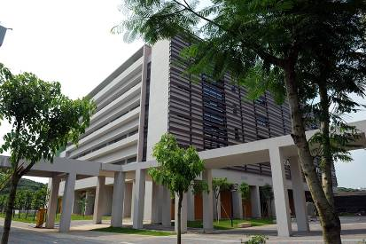
Engineering Electromagnetics
工程电磁场
Youwei Jia 嘉有为

Slide 2

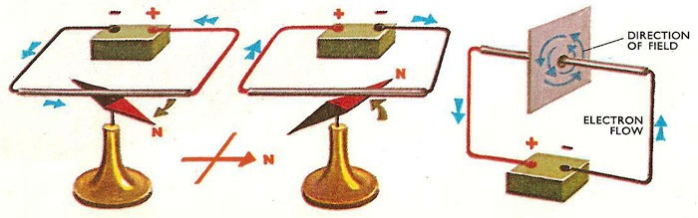
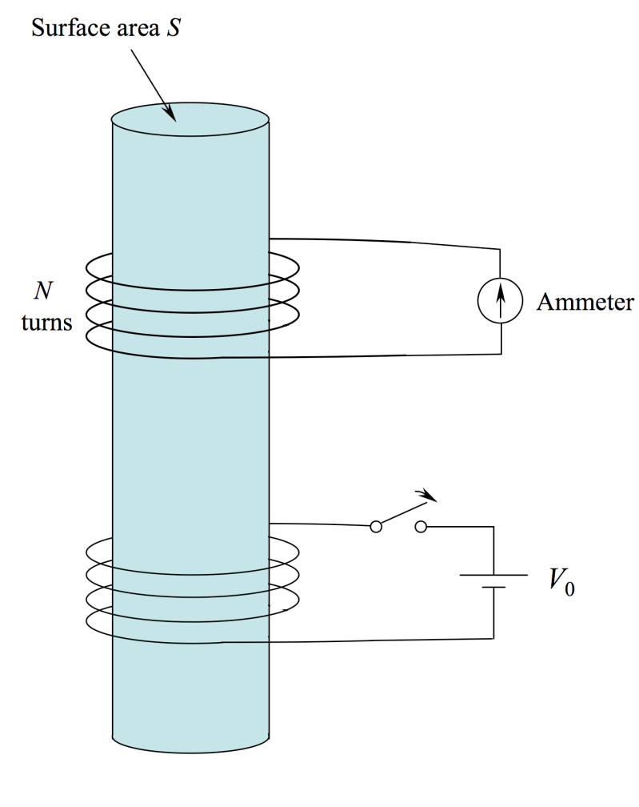
12: Time-Varying Fields 时变场
Faraday’s Experiment
The question addressed is: If a current can generate a magnetic field, then can a magnetic field generate a current?
An experiment similar to that conducted to answer
that question is shown here. Two sets of windings
are placed on a shared iron core. In the lower set,
a current is generated by closing the switch as shown.
In the upper set, any induced current is registered by
the ammeter.
1

Slide 3
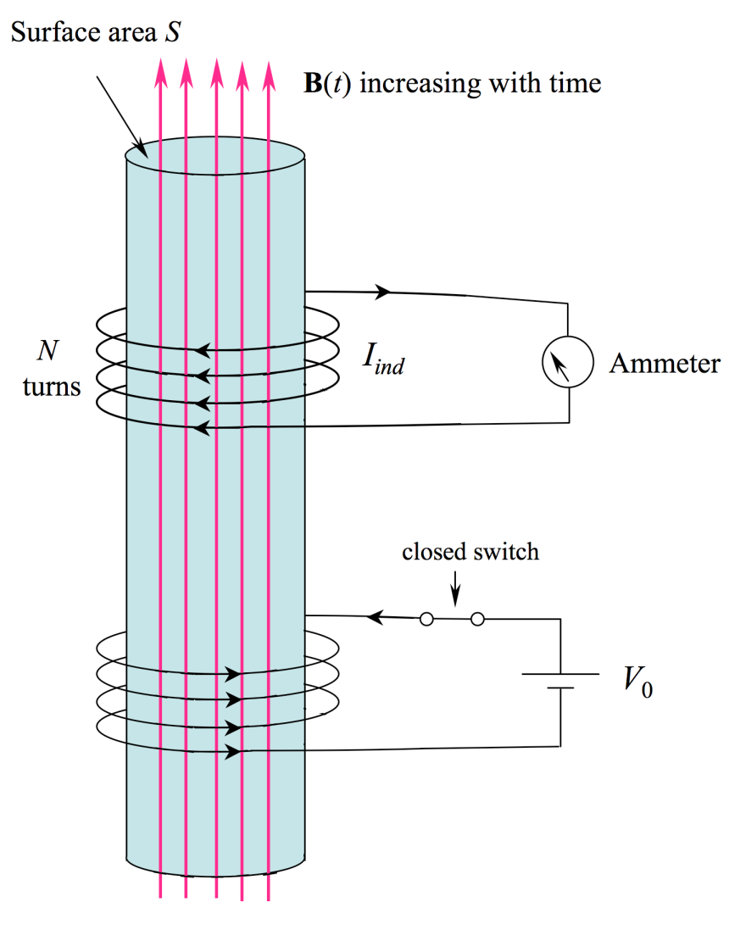
12: Time-Varying Fields
Faraday’s Experiment- Effect of Increasing B
Closing the switch results in current that initially increases with time in the lower windings. Magnetic flux density B is generated, which now links the upper
windings; these are found to carry current, I_{ind}. This current exists as long as B increases with time. Note the direction of the induced current and the position of the ammeter.
More specifically, the induced current is proportional to the time rate of change of the magnetic flux (the surface integral of B over S ).
2

Slide 4
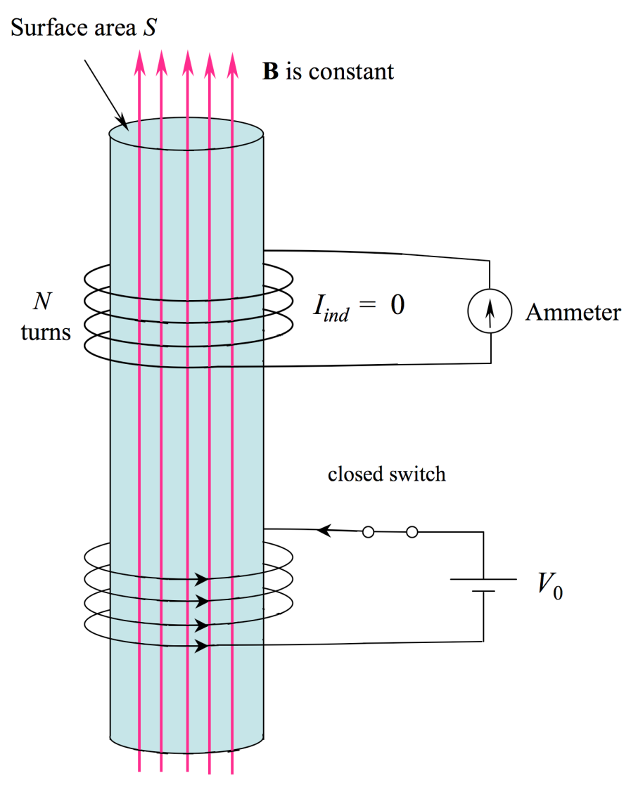
12: Time-Varying Fields
Faraday’s Experiment- Steady State
Once steady state is reached, in which B is at a constant value, the induced current is found to be zero.
3

Slide 5
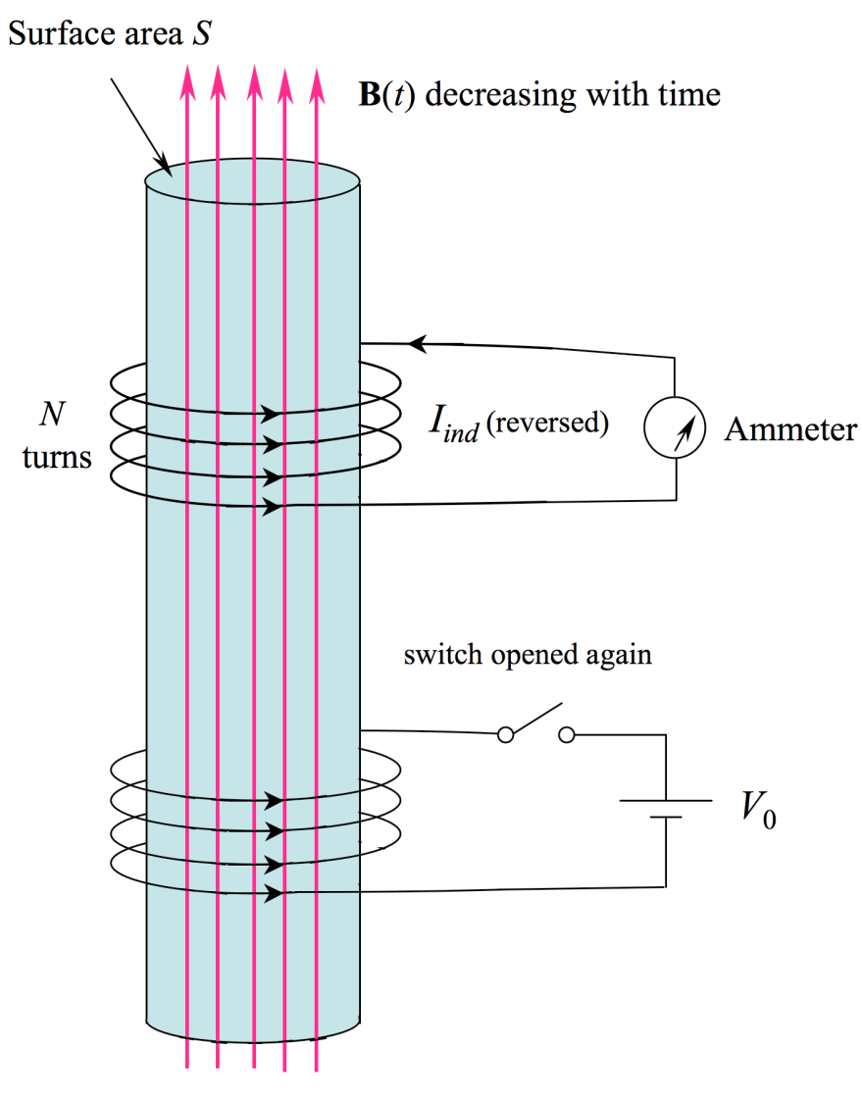
12: Time-Varying Fields
Faraday’s Experiment- Effect of Decreasing B
Opening the switch results in current that initially
decreases with time in the lower windings. Magnetic flux density B collapses, and the upper windings carry current, I_{ind} in the opposite direction from before. This current exists as long as the magnetic flux decreases with time.
Once B is reduced completely to zero, the induced current is zero as well.
4

Slide 6
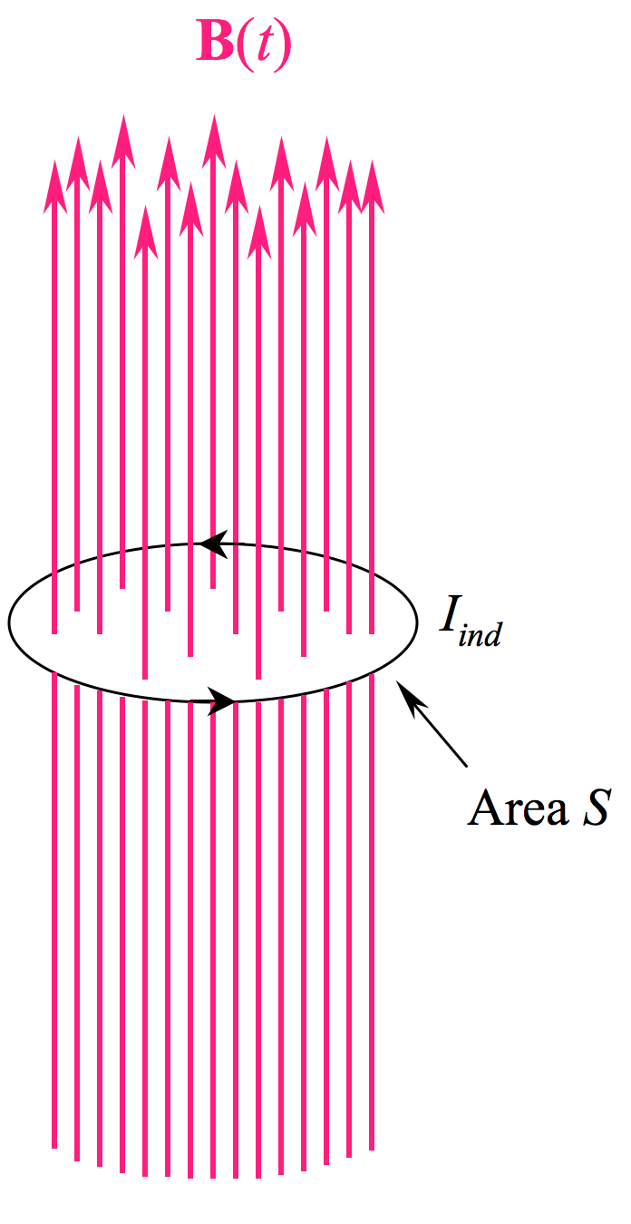
12: Time-Varying Fields
A Simpler Demonstration
Consider a single turn of wire, through which an externally-applied magnetic flux is present. The flux
varies with time.
A current, I_{ind} , is generated in the wire loop as a result of the changing magnetic flux.
5

Slide 7
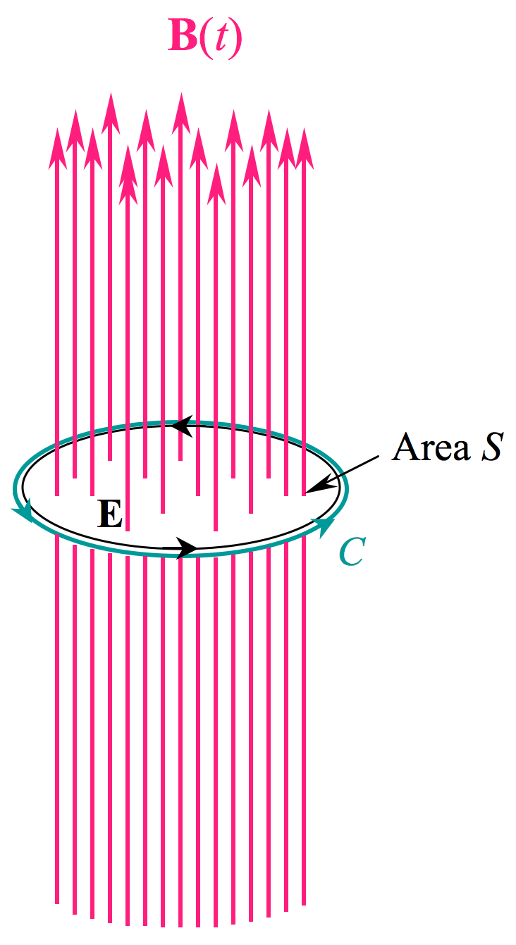
12: Time-Varying Fields
Replacing Current with Electric Field
Current in the wire is caused by electric field, E, that pushes the charge around the wire. In this illustration, the wire is removed, and the electric field remains. An integration contour, C, is also shown, that coincides with E.
6

Slide 8
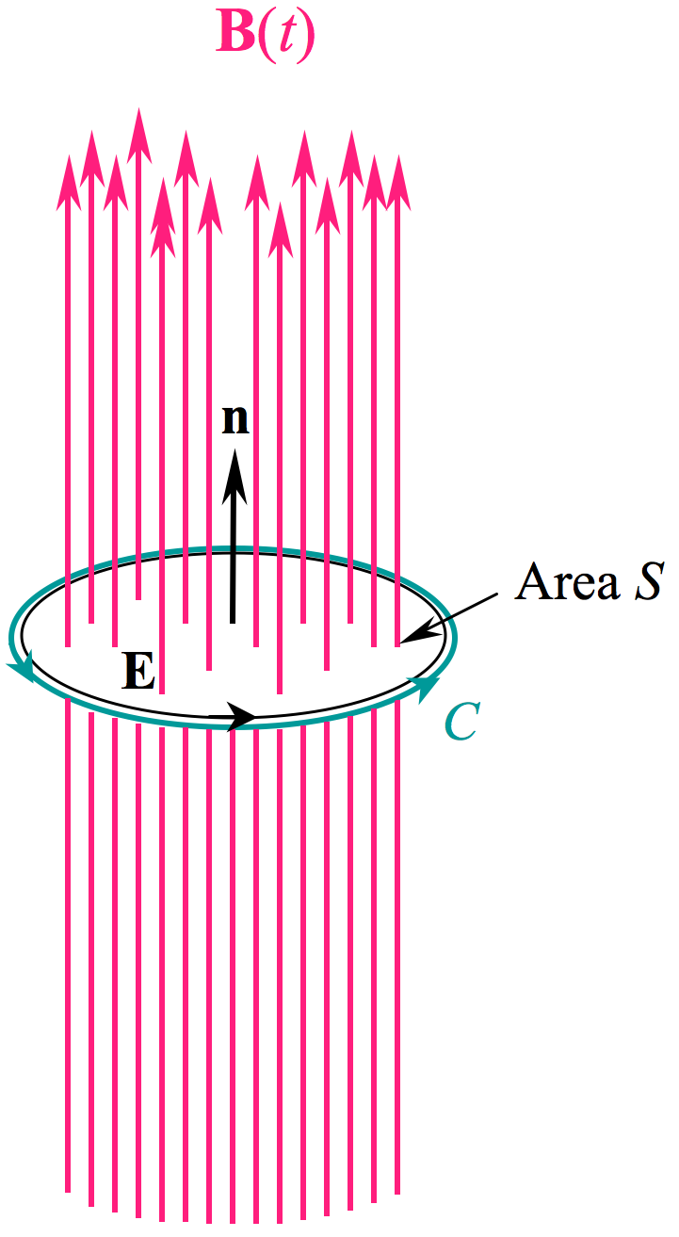
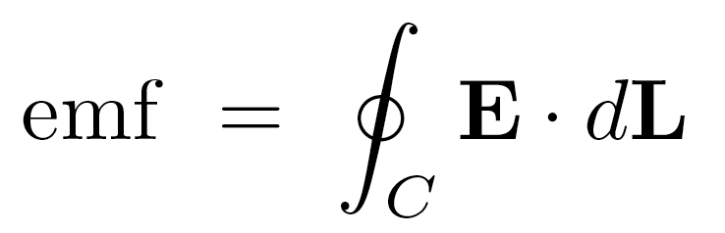
12: Time-Varying Fields
Electromotive Force (emf) 电动势
Next, a unit normal vector to the surface, n, is shown. The
relative directions of n, and the contour C are defined by the
right-hand convention: Right hand thumb in direction of n;
fingers then curve in the direction of C.
The electromotive force, or emf, is defined as the closed path
integral of E about C:
7

Slide 9
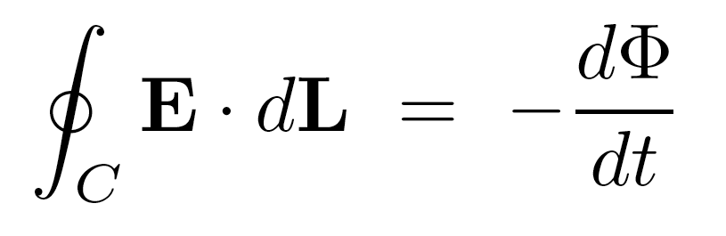
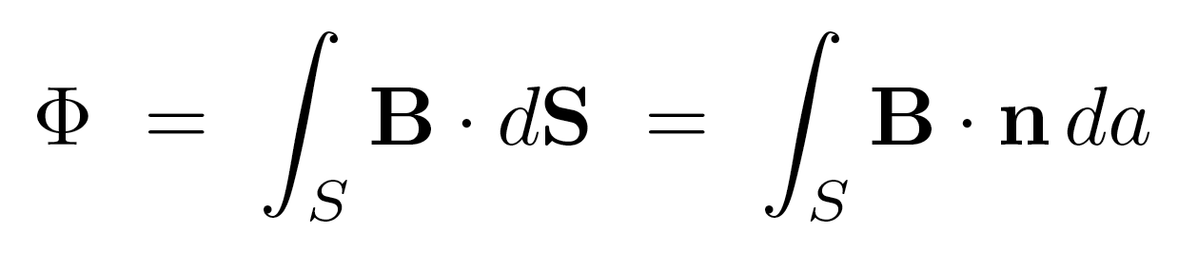
12: Time-Varying Fields
Faraday’s Law of Induction 电磁感应定律
Faraday’s Law states that the induced emf around a closed path
is equal to the time rate of change of the magnetic flux through
the area surrounded by the path:
where the flux is:
Note the use of the normal unit vector here, which determines the sign of the flux, and ultimately the emf.
8

Slide 10
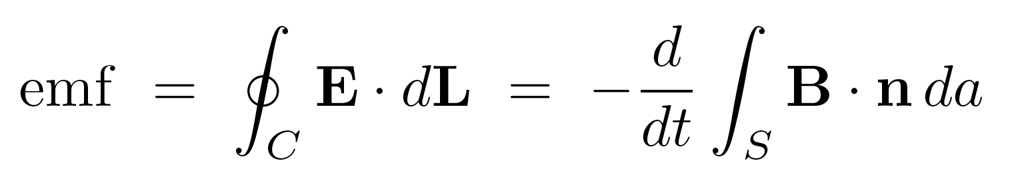
12: Time-Varying Fields
Faraday’s Law in Detail
Using the definitions of emf and the magnetic flux in this situation:
becomes:
9

Slide 11
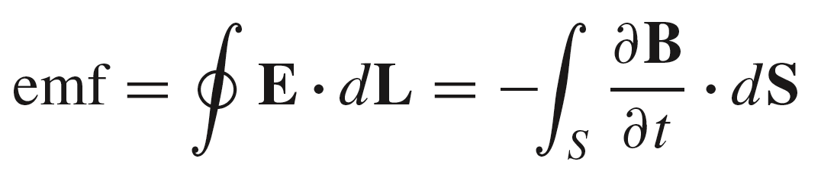
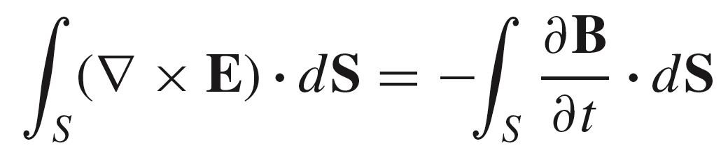
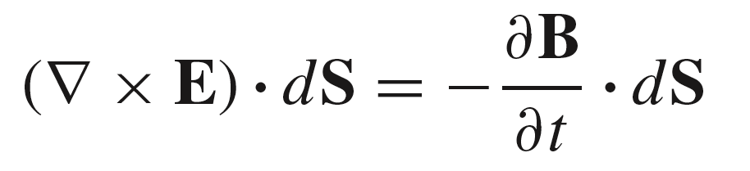
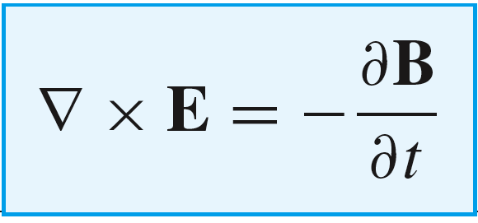
12: Time-Varying Fields
Alternative Expression for Faraday’s Law
(Another Maxwell Equation)
First, move the time derivative
into the interior of the right-hand
integral:
Second, use Stokes’ theorem to
write the line integral of E as the
surface integral of its curl:
Third, simplify by noting that both
integrals are taken over the same surface:
Finally, obtain the point form of
Faraday’s Law:
10

Slide 12
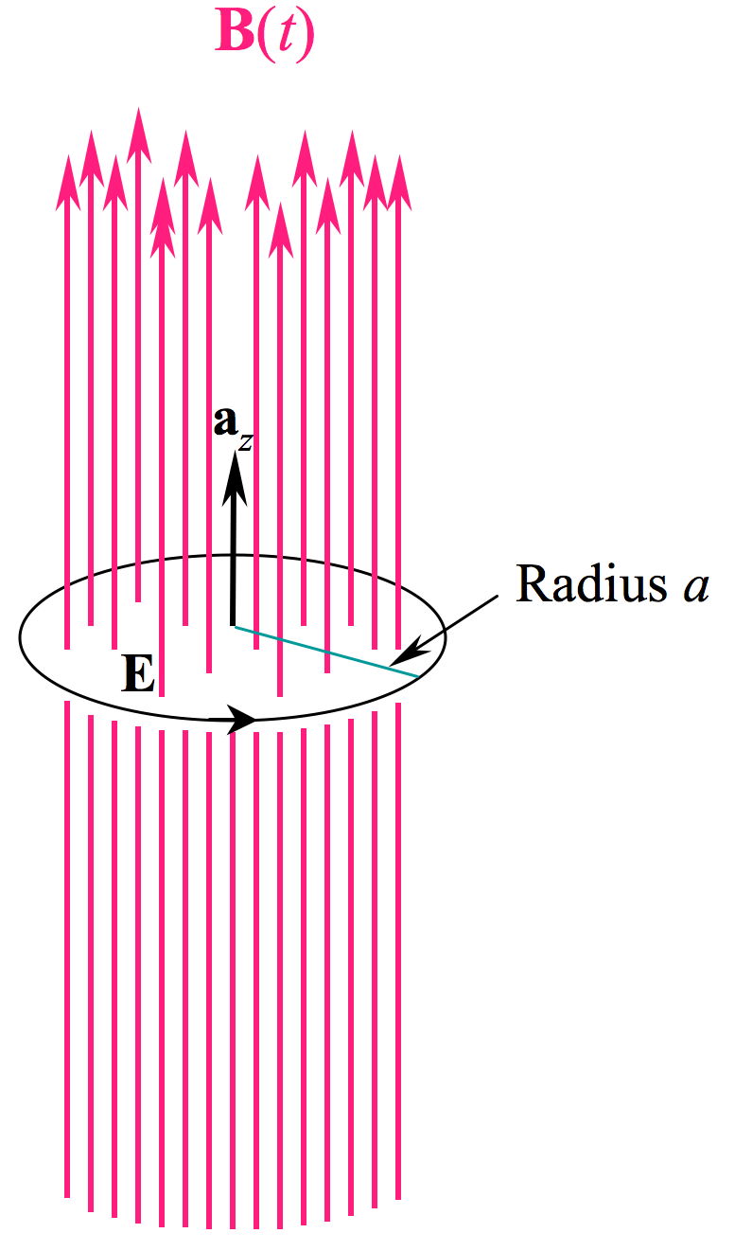
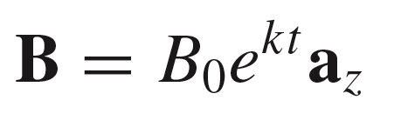
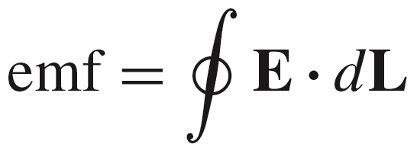
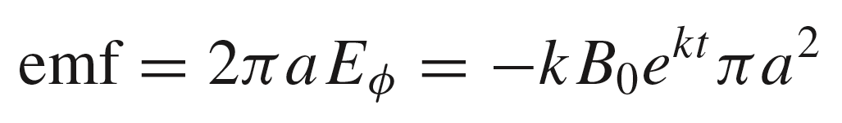
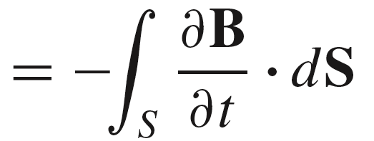
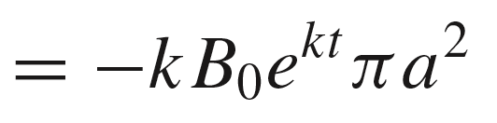
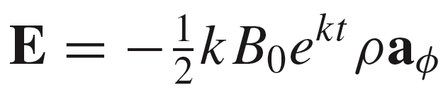
12: Time-Varying Fields
Example
Start with a uniform (but time-varying) field:
Then
As this calculation will work for any radius, we can replace the fixed radius with a variable radius and write:
11

Slide 13
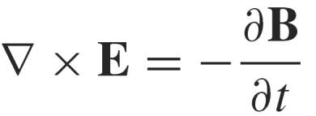

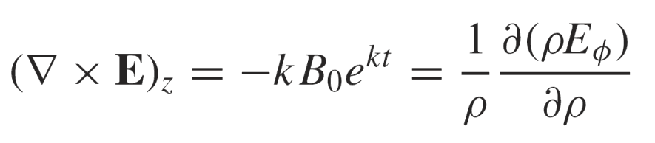

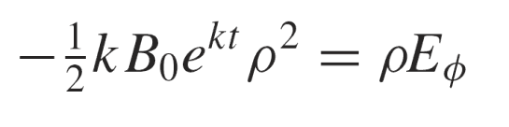
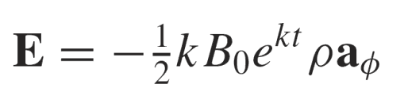
12: Time-Varying Fields
Example: Another Way…
This time use:
where
Therefore:
Surviving z-directed
curl component with
radial variation only
Multiply through by and integrate both sides:
Obtain, as before:
12

Slide 14
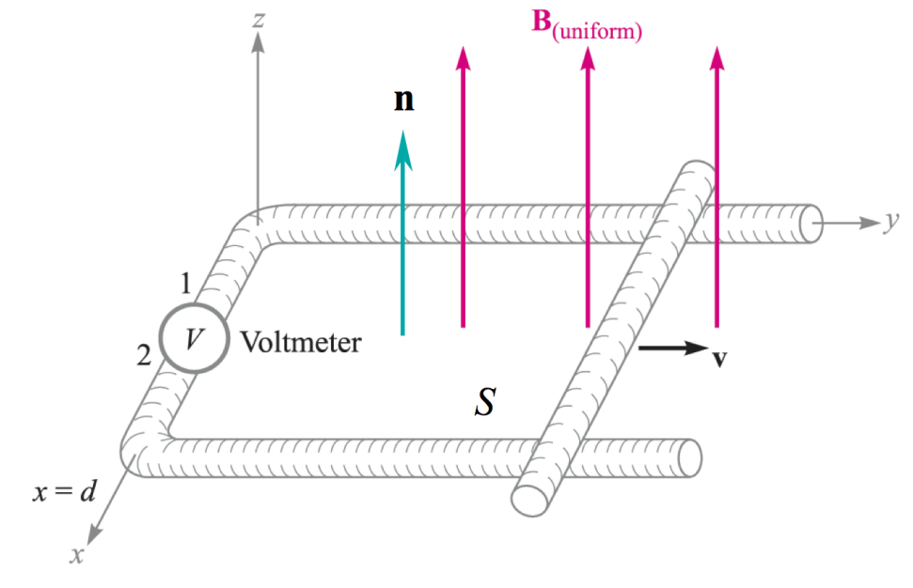
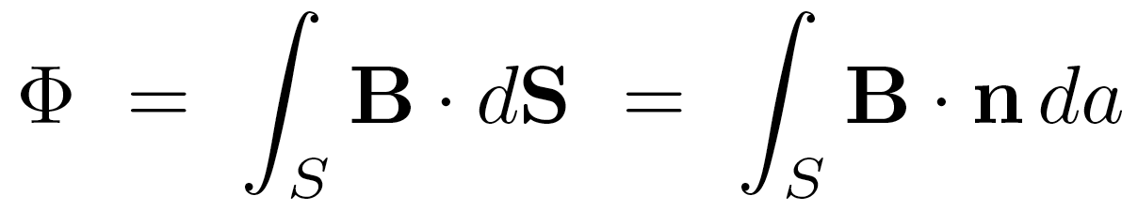
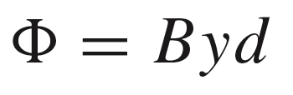
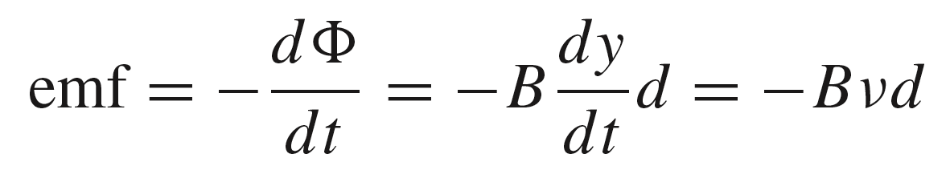
12: Time-Varying Fields
Induced emf from a Moving Closed Path
In the case shown here, the flux within a closed path
is increasing with time as a result of the sliding bar, moving at constant velocity v.
The conducting path is assumed perfectly-conducting, so that the induced emf appears entirely across the voltmeter.
The magnetic flux enclosed by the conducting path is
where the y dimension varies with time.
Therefore:
13

Slide 15
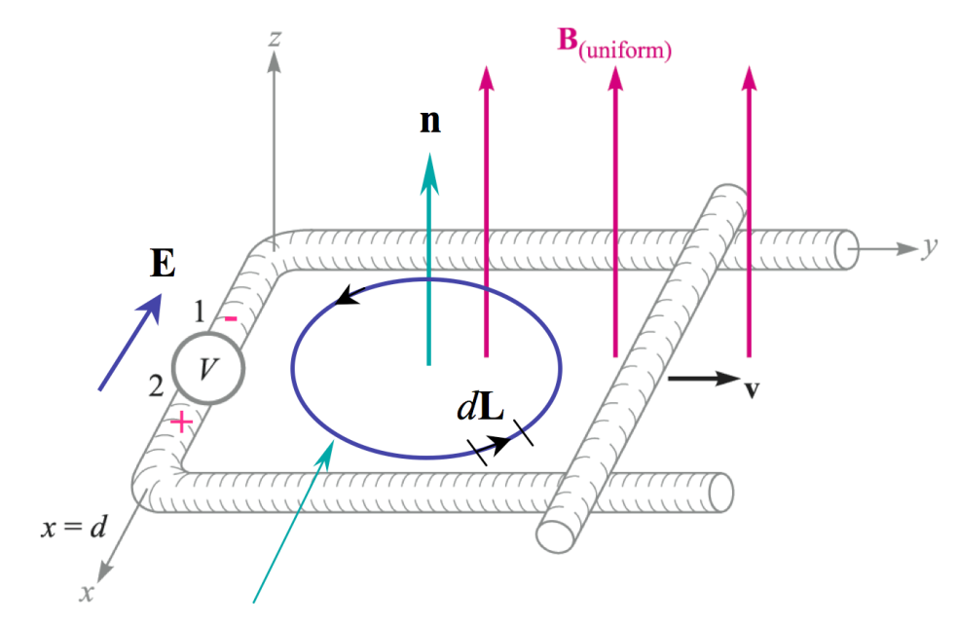
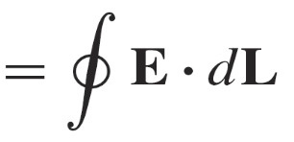

12: Time-Varying Fields
Finding the Direction of E
..so we have:
The E integration path direction is determined by the right hand convention (thumb of right hand in direction of n, fingers in direction of closed path). This is the direction of dL as shown in the figure.
From the equation, we see that is
negative, meaning that E will point from
terminals 2 to 1 as shown. As we have a
perfectly-conducing path, E will exist only
at the voltmeter.
Direction of integration
path of E through conductor
(by right hand convention)
14

Slide 16
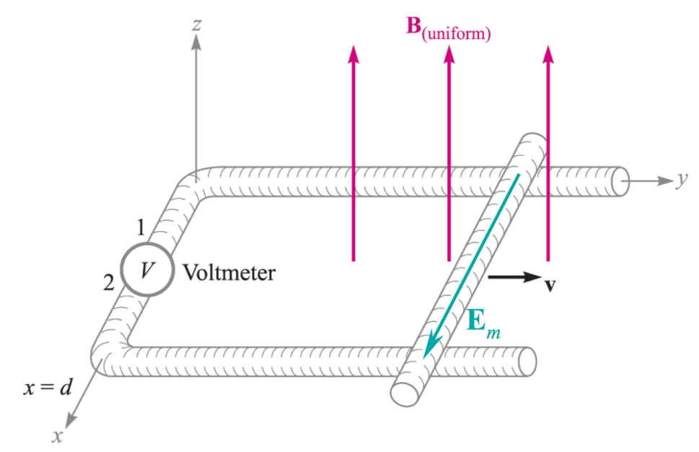
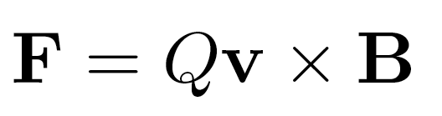
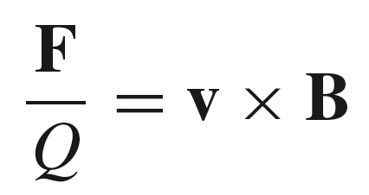
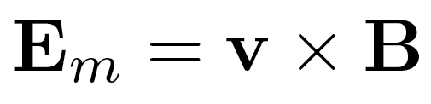
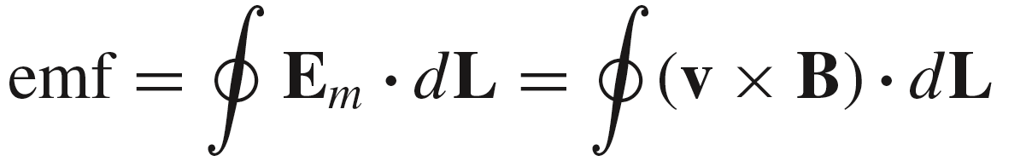
12: Time-Varying Fields
Motional emf 动生电动势
The sliding bar contains free charges (electrons) that experience
Lorentz forces as they move through the B field:
Recall:
and so..
This result is the motional field intensity:
..and so now the motional emf is the closed path integral of E_{m} over the same path as before.
Note: the motional field intensity exists only in the part of the circuit that is in motion.
15

Slide 17
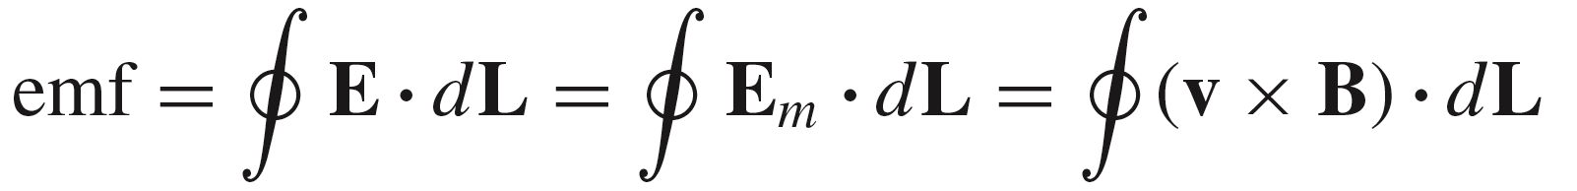
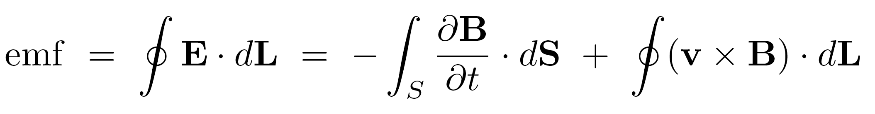
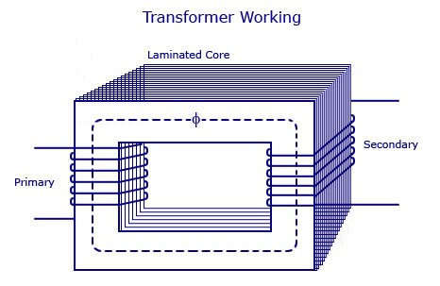
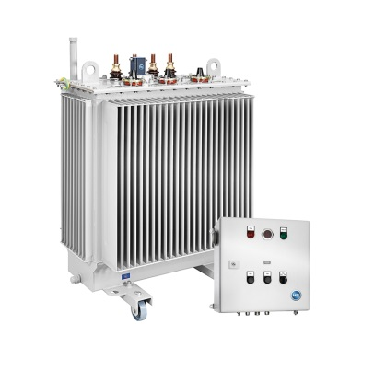
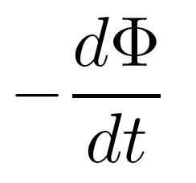
12: Time-Varying Fields
Two Contributions to emf
For a moving conducting path in an uniform field, the emf is composed entirely of motional emf:
When the B field is time-varying as well, then both effects need to be taken into account. The total emf is:
Transformer emf
Motional emf
16

Slide 18
12: Time-Varying Fields
Summary and rethinking
A time-changing magnetic field produces an electric field.
Q1: How about a time-changing electric field? Does it produce a magnetic field?
Q2: What is the probable source of magnetic field?
17

Slide 19
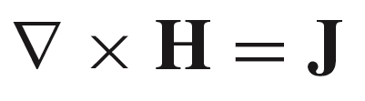
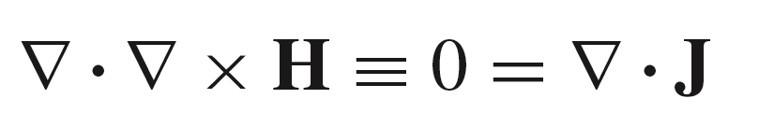
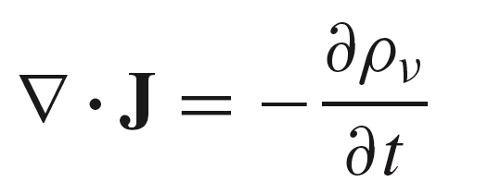
12: Time-Varying Fields
An Apparent Contradiction
Ampere’s Circuital Law:
Taking the divergence of the second equation gives us a result that is identically zero:
But a previous exercise gave us this result: the equation of continuity:
So what went wrong?
18

Slide 20

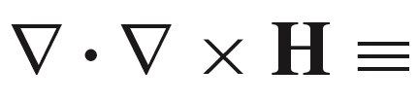
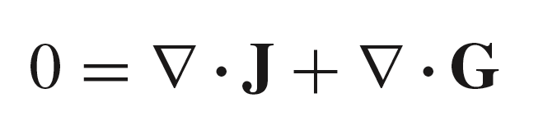
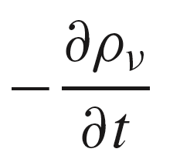





12: Time-Varying Fields
The Missing Term - Displacement Current Density
Suppose we add a term to the right-hand side of Ampere’s Law, whose identity we need to determine:
Added term to
be identified
Now take the divergence:
From the equation of continuity
This must be true
So now:
..from which:
Now, Ampere’s
Law is modified:
This term is the displacement current density
19

Slide 21






12: Time-Varying Fields
Symmetry in the Curl Equations
Our new result states that the total current
is composed of conduction current 传导电流 or convection current 运流电流 and displacement current 位移电流:
where the displacement current density is:
Conduction current density is :
Convection current density is :
In the absence of conduction/convection
current, and when fields are
time-varying, we have:
Note the symmetry when
comparing to Faraday’s Law:
20

Slide 22



12: Time-Varying Fields
Displacement Current in Ampere’s Law
Displacement current is found from displacement current density by taking the appropriate surface integral:
Such an integral of Ampere’s Circuital Law curl equation gives:
Applying Stokes’ Theorem to the left side gives the more familiar form of Ampere’s Law, now with displacement current added:
21

Slide 23



12: Time-Varying Fields
Demonstration of Displacement Current
In this situation, a time-varying magnetic field links a wire loop that is connected to a parallel-plate capacitor.
The magnetic field is presumed time-varying, and thus it
generates emf, which in turn provides the current.
We assume for the moment that
conduction current I exists in the
wire. Ampere’s Law is applied to
the circular path shown, whose radius
is very small compared to the local
wire length. The wire therefore appears
very long and straight. We obtain:
S
H
I
k
The integration surface is the flat plane whose perimeter is
the circlular path, k. We assign the z direction (locally) to be
along the current where it passes through the plane.
22

Slide 24

12: Time-Varying Fields
Demonstration of Displacement Current
While current is flowing, the electric field in the capacitor is changing with time, in step with the plate charge level, deposited by the current.
S
H
The capacitor voltage is V₀(t).
Taking the capacitor axis as z,
assuming free space permittivity,
and with cap dimensions as indicated,
the time-varying electric flux density
within it is:
D
23

Slide 25



12: Time-Varying Fields
Demonstration of Displacement Current
Now suppose the surface S,
surrounded by the original contour, k, is stretched so that it intercepts the electric field between capacitor plates:
Stretched surface now intercepts electric field lines,
and no conduction current
Ampere’s Law is again applied,
but this time we need to use the
displacement current in the capacitor:
H
The result must be independent of the surface
that is chosen, which leads to the conclusion that the conduction and displacement currents must be equal:
a familiar
result!
24

Slide 26

13: Maxwell’s Equations
Maxwell’s Equations in Point Form
Ampere’s Circuital Law
Faraday’s Law of Induction
Gauss’ Law for the electric field
Gauss’s Law for the magnetic field
25

Slide 27




13: Maxwell’s Equations
Ampere’s Circuital Law in Integral Form
Take the surface integral of the point form equation:
I
I_{d}
Apply Stokes’s Theorem to the left hand side:
mmf
where
Remember to use the right hand
convention on relating path direction to the normal vector.
26

Slide 28



13: Maxwell’s Equations
Faraday’s Law of Induction in Integral Form
Take the surface integral of the point form equation:
Apply Stokes’s Theorem to the left hand side:
emf
Remember to use the right hand
convention on relating path direction
to the normal vector.
27

Slide 29



13: Maxwell’s Equations
Gauss’s Law for the Electric Field in Integral Form
Begin with:
and integrate both sides over a volume, v:
Apply the divergence theorem to the left hand side:
28

Slide 30



13: Maxwell’s Equations
Gauss’s Law for the Magnetic Field in Integral Form
Begin with:
and integrate both sides over a volume, v:
Apply the divergence theorem to the left hand side:
29

